Slide 1
Medieval Political Philosophy challenging Church authority
Dr. Stephanie Spoto
4/17/2019
Monterey Peninsula College
Gentrain 406: The Medieval Renaissance and the High Middle Ages

Slide 2
Medieval political philosophy
No consensus as to when this period begins or ends
  Conventional to claim that it begins with Augustine (354-430), and continues past Descartes (1596-1650)
Attempted to influence public events → history of medieval political philosophy often references those events → understands the philosophy in context
Tied to developments in medieval culture as well as institutions such as universities and codified legal systems.
Strong relationship between religion and politics → political philosophy almost had to situate itself in relationship to the church.

Slide 3
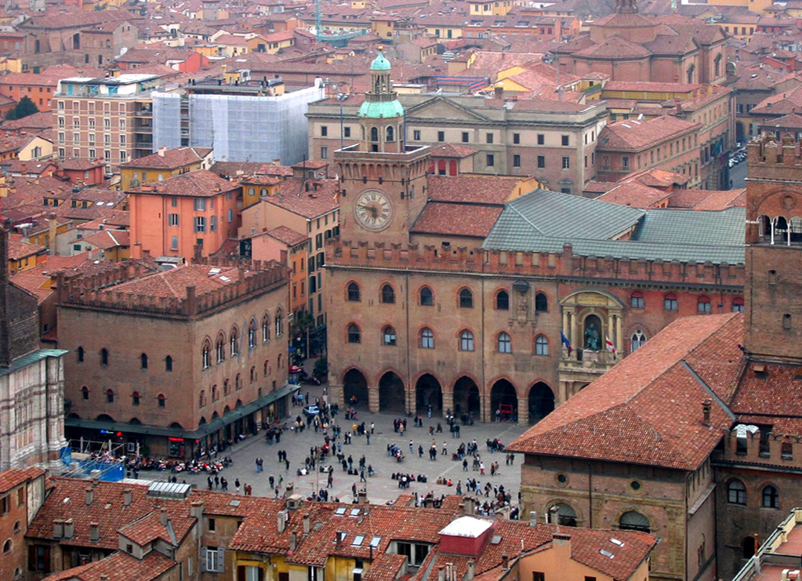
Church vs Universities
Universities began to appear in major cities
Rival clerical orders competed for influence within the universities
Scholars and philosophers also worked for intellectual autonomy from the church
The University of Bologna in Italy, founded in 1088, is the oldest university, the word university (Latin: universitas) having been coined at its foundation.

Slide 4
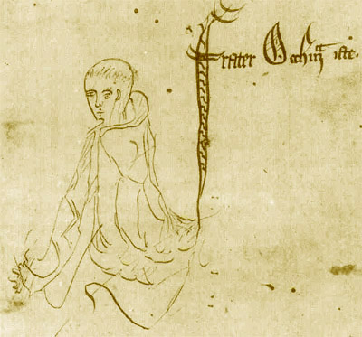
William of Ockham c. 1287 – 1347
Challenged popular synthesis of faith and reason → excommunicated from the Catholic Church
God is a matter of faith and not knowledge → rejected all alleged proofs of the existence of God.
Politics: supported the separation of church from political rule and supported freedom of speech.
William of Ockham – Sketch labelled "frater Occham iste", from a manuscript of Ockham's Summa Logicae, 1341

Slide 5
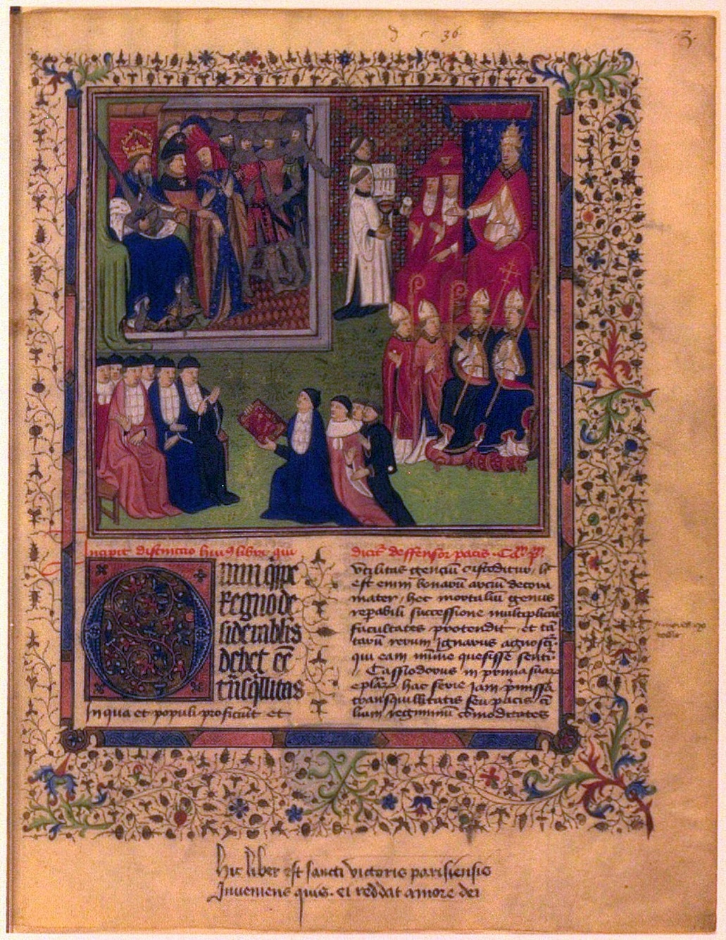
Marsilius of Padua c. 1275 – c. 1342
Defensor Pacis (Defender of the Peace) → very critical of papal politics.
There needed to be limitation to the church authority
Secular state's responsibility to maintain of law and order.
When the treatise became known, Marsilius of Padua had to flee from Italy for his safety and was considered a heretic.
Excommunicated in 1327
Miniature on the first page of a luxury manuscript of the Defensor pacis (15th century). Marsilius is shown presenting a copy to the Emperor

Slide 6
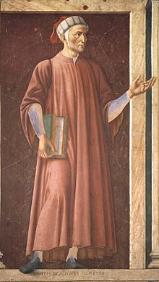
Dante Alighieri c. 1265 – 1321
Exiled from his home in Florence
Longed for peace and to return
Politically, could not rely on pope
Little faith in citizen democracy
  Portrayed as a pillaging evil that has infected Florence
Put hopes on Emperor Henry VII (1310-1313 CE)
Mural of Dante in the Uffizi Gallery, by Andrea del Castagno, c. 1450

Slide 7
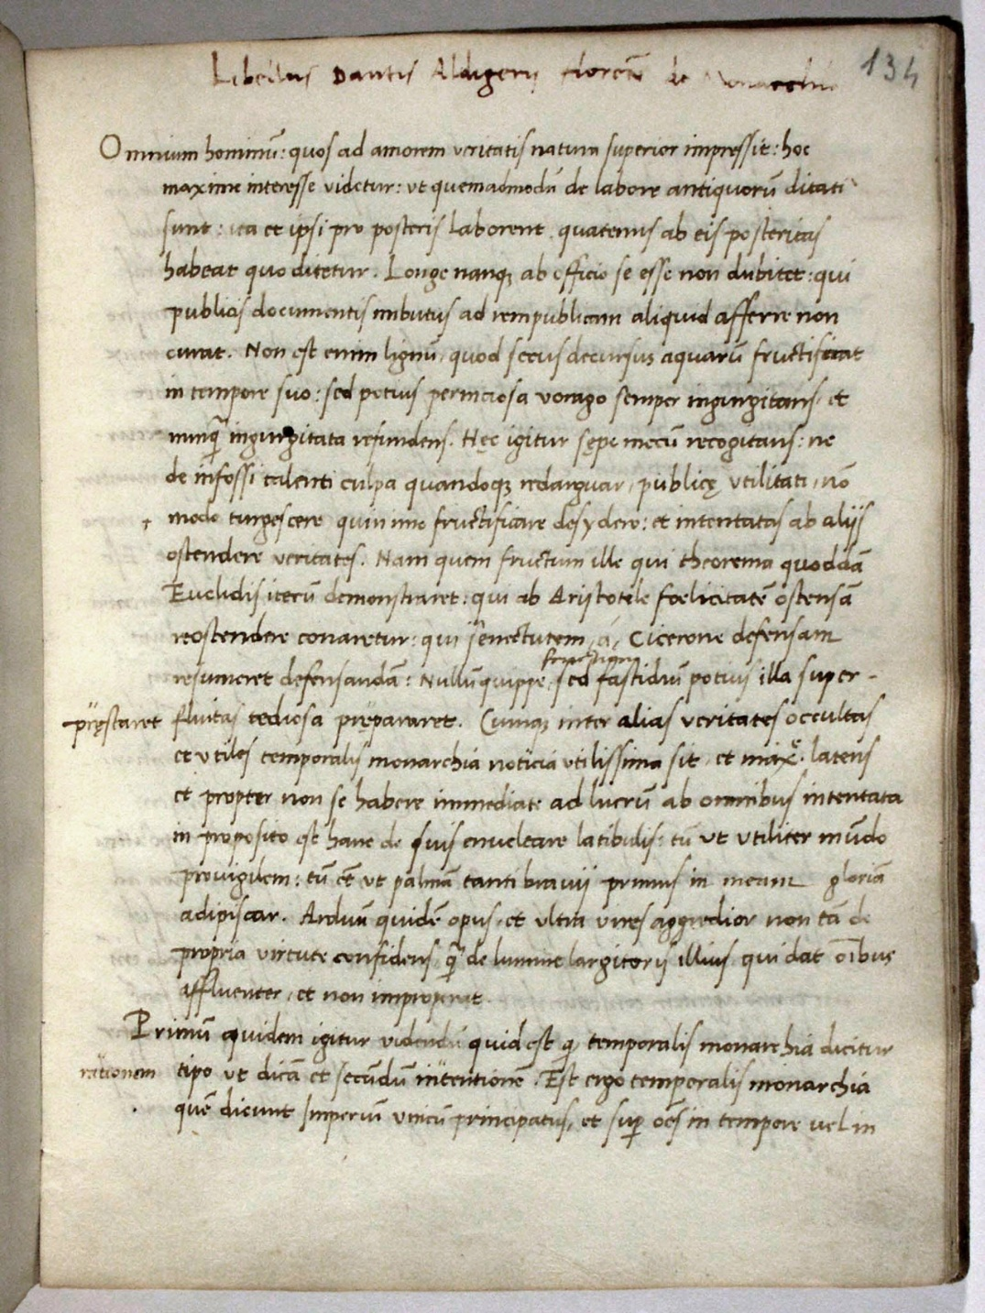
De Monarchia c. 1312-1313
Written within this political and personal context
Co-operation between cities, developing peace, returning exiles → so people can develop as individuals
Competing claims to universality
  Pope Boniface VIII (Papal Bull Unam Sanctam 1302)
  Emperor Henry VII (universal world domination)
The Trivulziano Codex 642, early 1500s possibly in Milan for personal reading

Slide 8
The Universal Monarchy
Material purpose of laying foundations for peace, freedom, and justice.
To serve individual happiness → not communities deprived of individuals
Freedom of volition is the greatest gift that God has given human nature
Individual freedom is cognitive, intellectual → threatened by politics
  When people act politically, individual freedom is threatened by desires of political actors
But a universal monarch would have no desires → therefore only he can be purest subject of justice
Pope assigned to humankind’s eternal life (soul), but the monarchy assigned to humankind’s earthly life

Slide 9
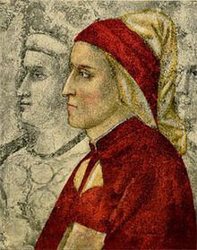
The Individual over the State
Individual human happiness foregrounded
Move towards individual liberty → citizens do not exist for the sake of government/consuls → people do not exist for the sake of the king
Consuls are subject to the will of the citizens → King subject to will of the people
Monarch becomes a servant to the people
‘So, the human species comes off best under the rule of the monarch. It follows that the monarchy is necessary for the good of the world’ (Book I, Chapter I)
Dante Alighieri, attributed to Giotto, Bargello Palace (Florene). This oldest picture of Dante was painted just prior to his exile and has since been heavily restored.

Slide 10
The Three Books of the Monarchia
Three Arguments for the Universal Monarchy
Book I: Purpose of Peace → Protection of individual and individual happiness
Book II: reaches back to the first principle of unity, the principium unitatis, as the basis of the moral order (universal empire).
  Secular monarchy → Christian emperor whose authority comes directly from God
Book III: Defends papal power and imperial power separately.
  Man has two aspects: physical and immortal aspect → needs two separate powers to influence each sphere

